Slide 1
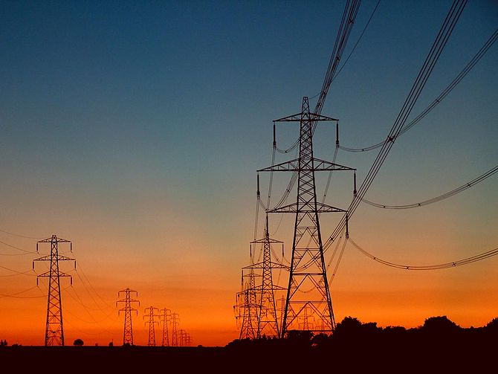
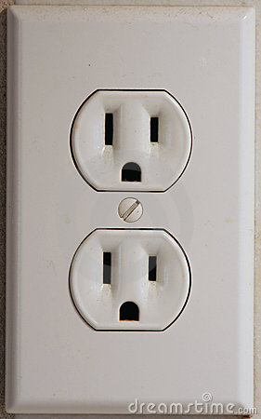
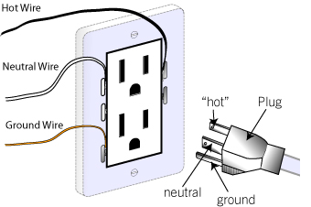
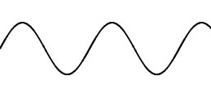
The AC Power Grid
60 Hz, 120 V_{RMS}

Slide 2
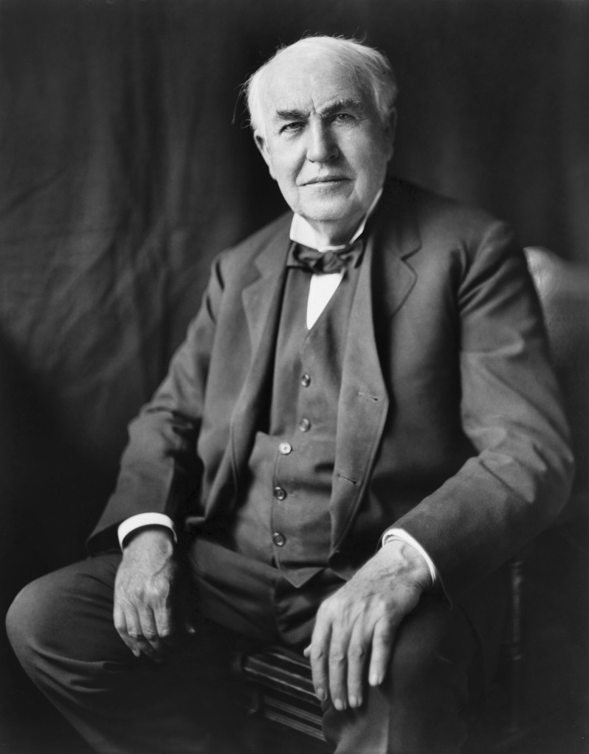
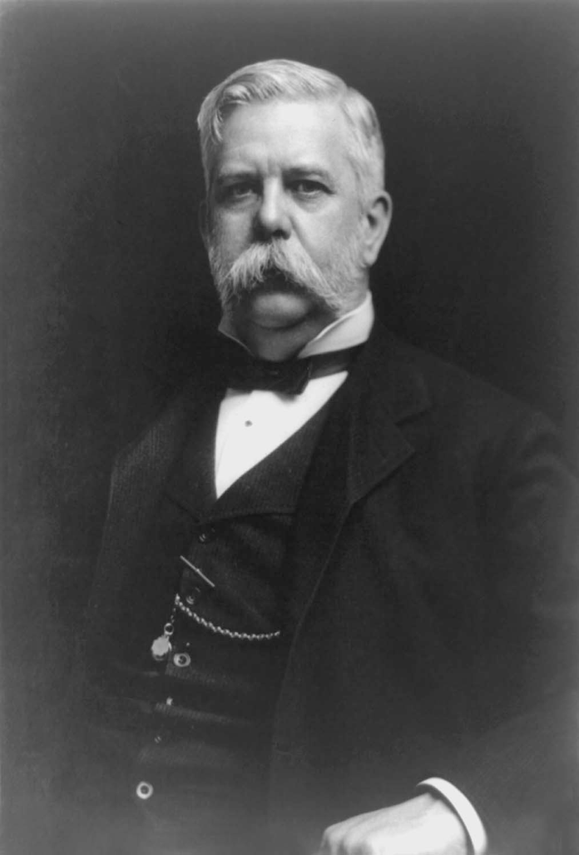


DC vs. AC
In the late 1800s, these two guys fought fiercely over the power grid.
Thomas Edison - DC
Westinghouse - AC
VS.

Slide 3
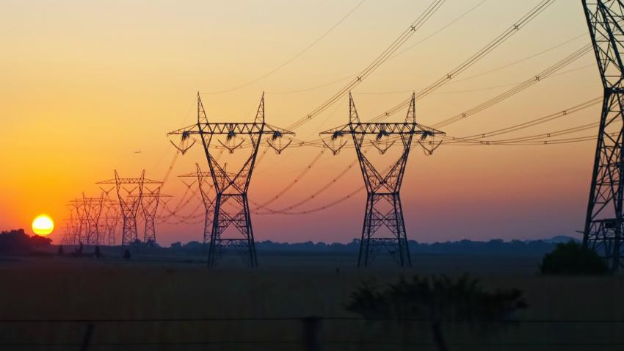
Why did AC win?
Transmission lines have some resistance, so energy is lost to Joule heating.

Slide 4
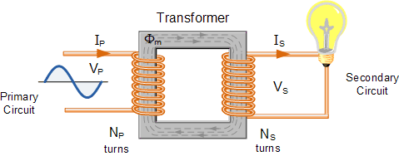
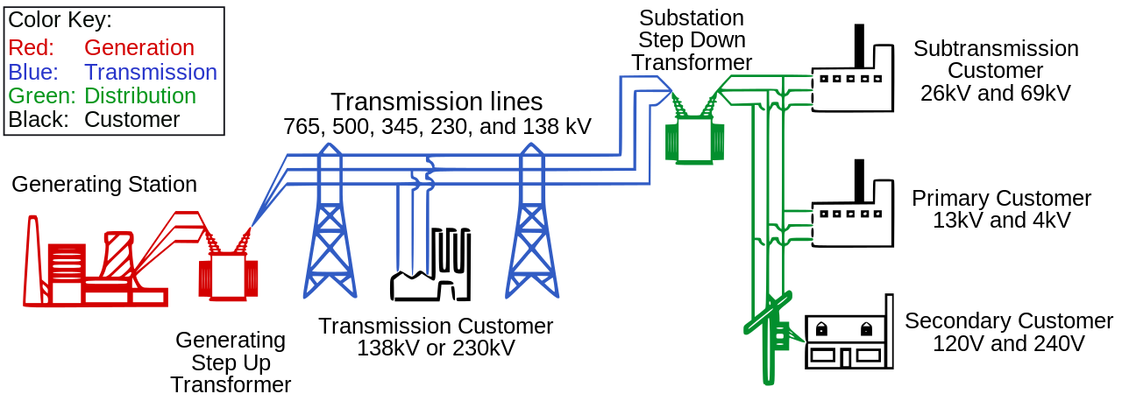
High Voltage Transmission Lines
AC voltages can easily be increased using a transformer.

Slide 5
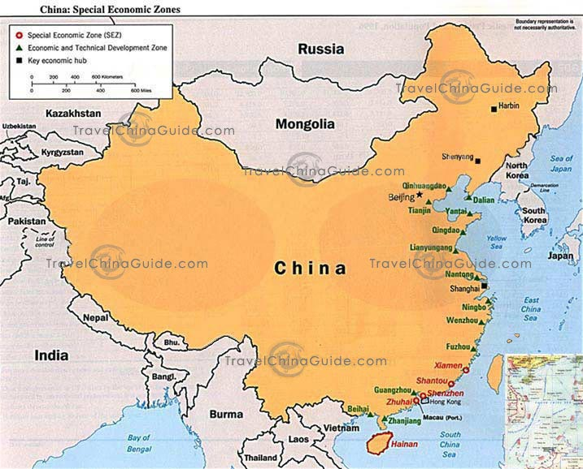
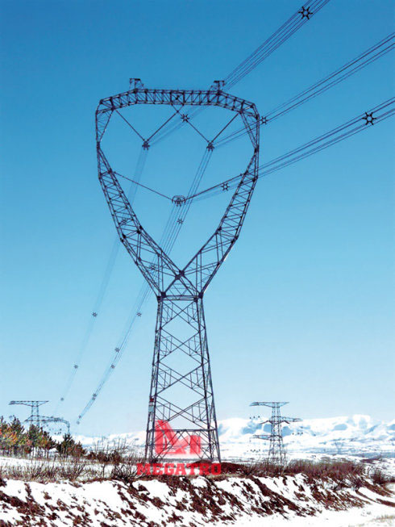
Power Grids of the Future
Power in sent across the country by1 Million volt transmission lines!
In China, much of the population lives on the east coast.
But most of the energy resources are located in the west.

Slide 6
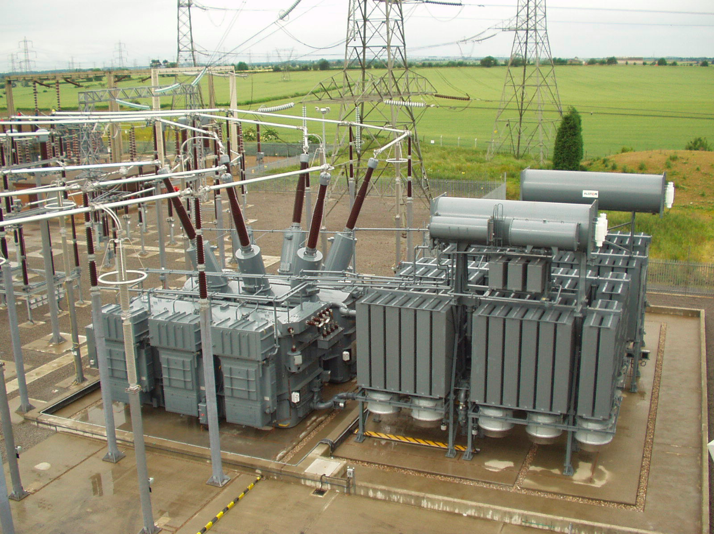
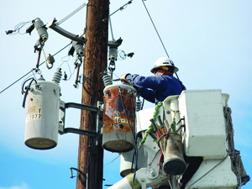
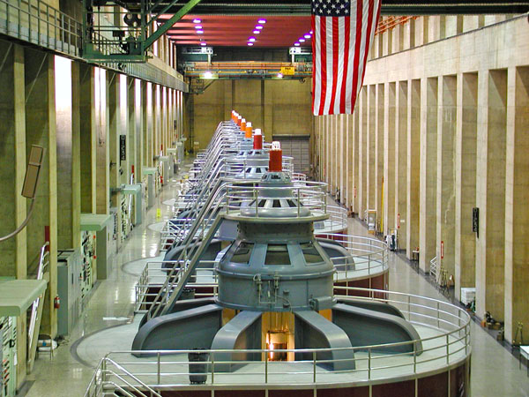
Meanwhile, back in the USA…
Much of the electrical infrastructure in the US is over 50 years old, close to the end of its estimated lifetime.

Slide 7
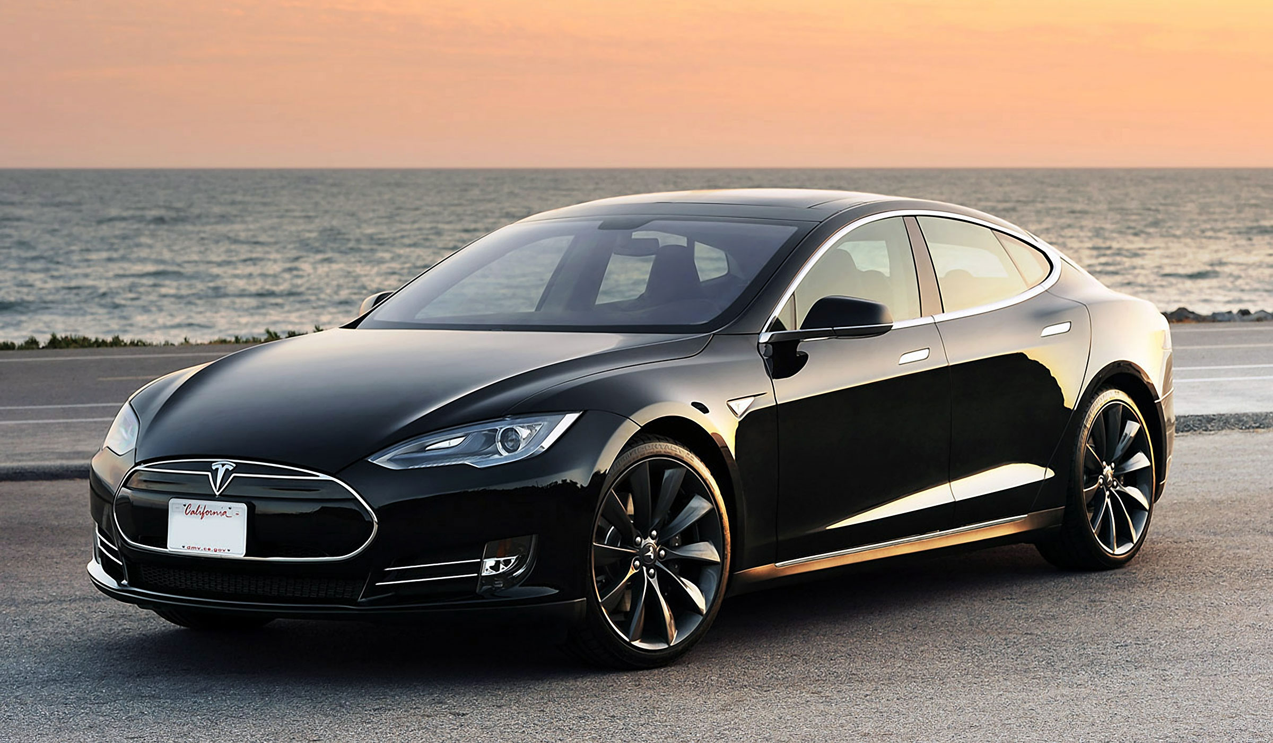
Tesla Models S – All electric, 400 HP

Slide 8
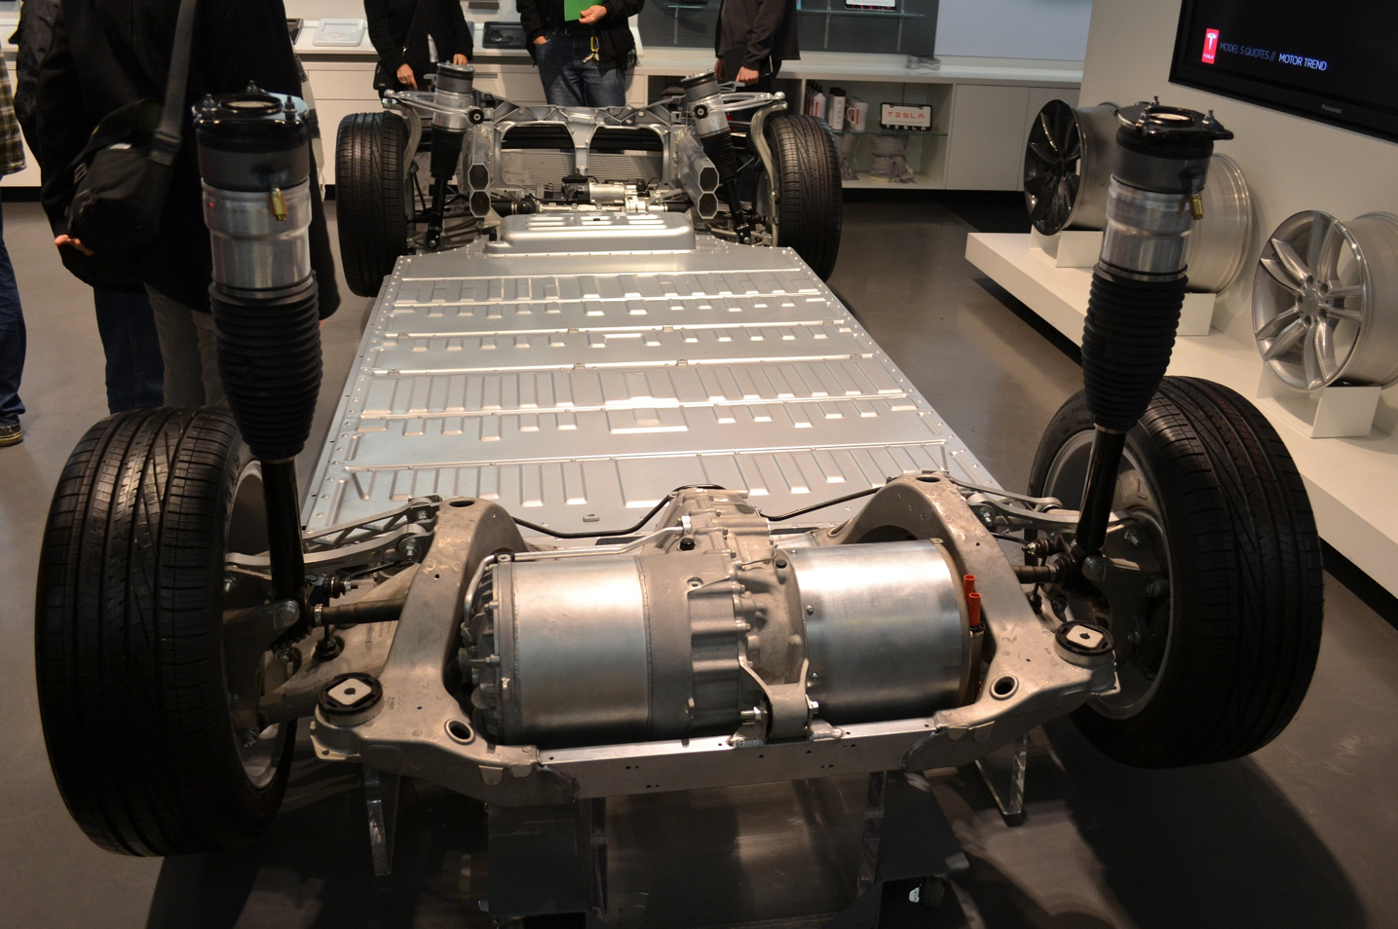
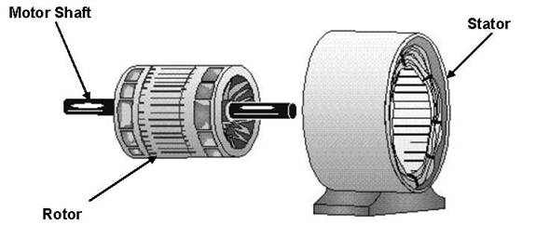
AC Induction Motor – 1,000 Amps at 300 V
300,000 W = 400 HP

Slide 9
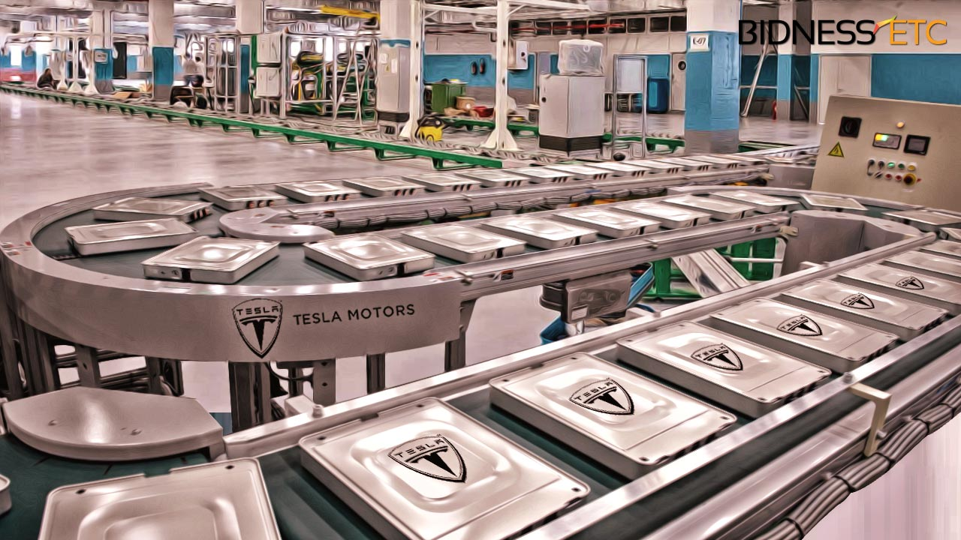
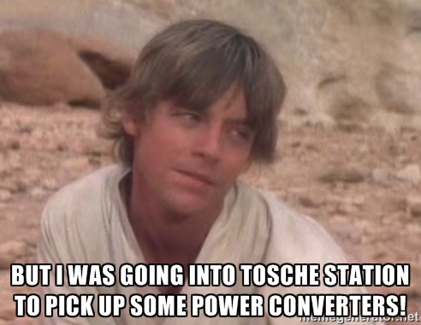
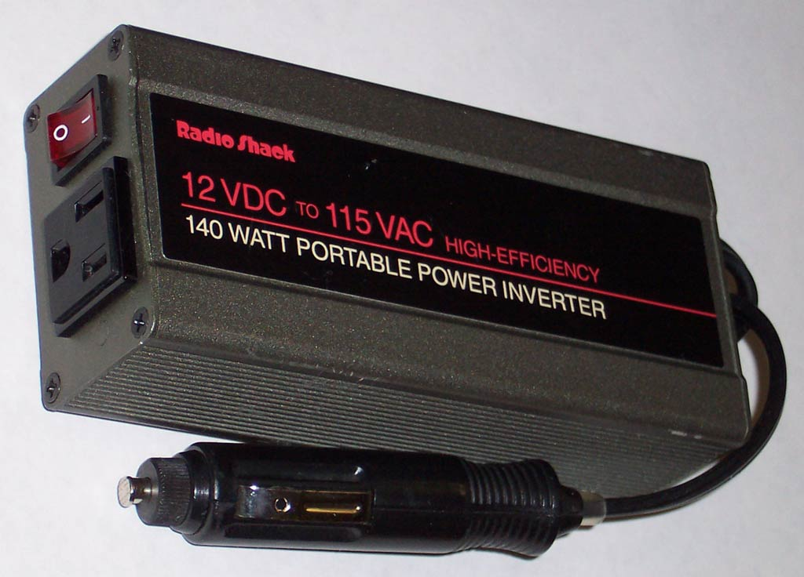
Power Inverter - DC to AC Conversion
Q: Lithium ion batteries are DC, so why not just use a DC motor?
A: DC motors require rare earth magnets.

